Slide 1





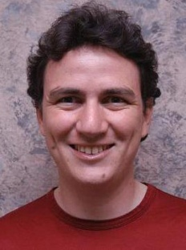

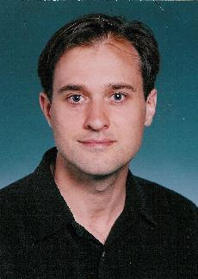
PowerGraph
Distributed Graph-Parallel Computation on Natural Graphs
Joseph Gonzalez
The Team:
Yucheng
Low
Haijie
Gu
Aapo
Kyrola
Danny
Bickson
Carlos
Guestrin
Alex
Smola
Guy
Blelloch

Slide 2
BigGraphs are ubiquitous..

Slide 3

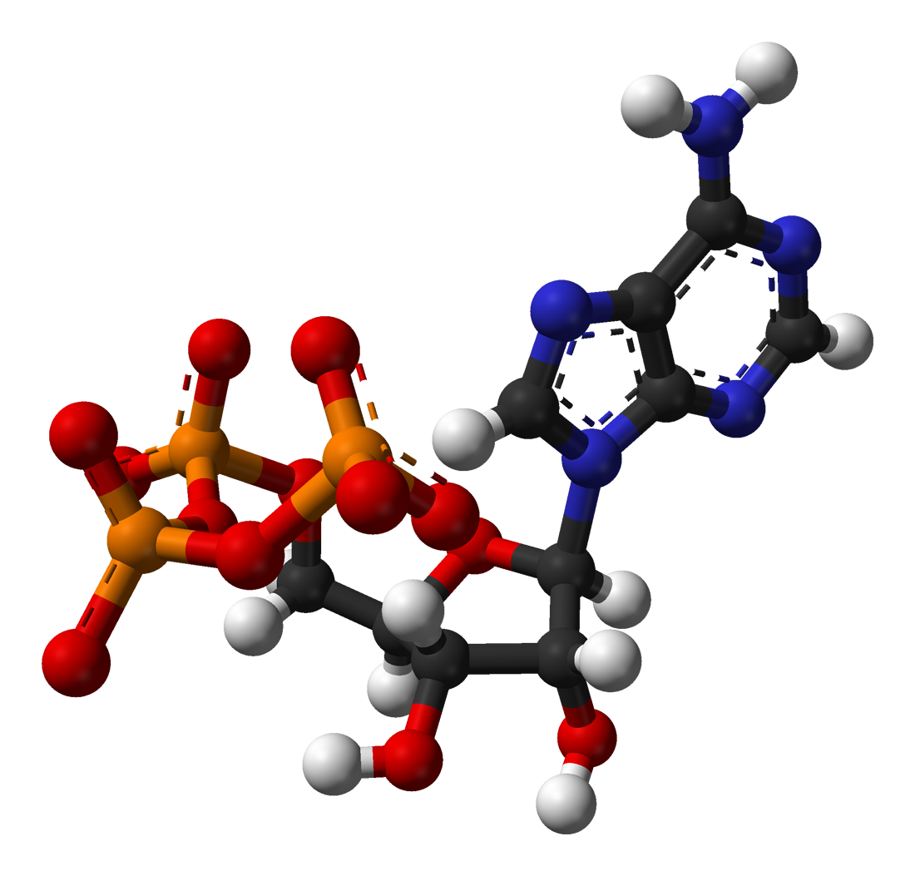

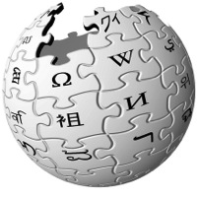




Social Media
Science
Advertising
Web
Graphs encode relationships between:
Big: billions of vertices and edges and rich metadata
People
Products
Ideas
Facts
Interests

Slide 4
Graphs are Essential to Data-Mining and Machine Learning
Identify influential people and information
Find communities
Target ads and products
Model complex data dependencies

Slide 5
Natural Graphs Graphs derived from natural phenomena

Slide 6
Existing distributed graph computation systems perform poorly on Natural Graphs.
Problem:

Slide 7
PageRank on Twitter Follower Graph
Natural Graph with 40M Users, 1.4 Billion Links
Order of magnitude by exploiting properties of Natural Graphs
PowerGraph
Hadoop results from [Kang et al. '11]
Twister (in-memory MapReduce) [Ekanayake et al. ‘10]

Slide 8
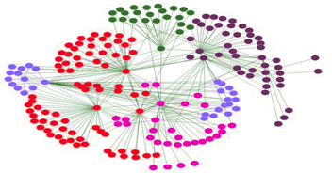
Properties of Natural Graphs
Regular Mesh
Natural Graph
Power-Law Degree Distribution

Slide 9
Power-Law Degree Distribution
More than 10⁸ vertices have one neighbor.
High-Degree
Vertices
Top 1% of vertices are adjacent to
50% of the edges!
-Slope = α ≈ 2
Number of Vertices
AltaVista WebGraph
1.4B Vertices, 6.6B Edges
Degree

Slide 10

Power-Law Degree Distribution
“Star Like” Motif
President
Obama
Followers

Slide 11
Power-Law Graphs are Difficult to Partition
CPU 1
CPU 2
Power-Law graphs do not have low-cost balanced cuts [Leskovec et al. 08, Lang 04]
Traditional graph-partitioning algorithms perform poorly on Power-Law Graphs. [Abou-Rjeili et al. 06]

Slide 12
Properties of Natural Graphs
High-degree
Vertices
Power-Law
Degree Distribution
Low Quality
Partition

Slide 13
PowerGraph
Program
For This
Run on This
Machine 1
Machine 2
Split High-Degree vertices
New Abstraction → Equivalence on Split Vertices

Slide 14
How do we program graph computation?
“Think like a Vertex.”
-Malewicz et al. [SIGMOD’10]

Slide 15
The Graph-Parallel Abstraction
A user-defined Vertex-Program runs on each vertex
Graph constrains interaction along edges
Using messages (e.g. Pregel [PODC’09, SIGMOD’10])
Through shared state (e.g., GraphLab [UAI’10, VLDB’12])
Parallelism: run multiple vertex programs simultaneously

Slide 16
Data-Parallel vs. Graph-Parallel Tasks
Data-Parallel Graph-Parallel
Map-Reduce
GraphLab & Pregel
Feature Extraction
Summary Statistics
Graph Construction
PageRank
Community Detection
Shortest-Path
Interest Prediction
Notes:
In Analogy to Data-Parallel abstractions like Map-Reduce which focus on tasks like feature extraction and computing summary statistics, Graph-Parallel abstractions like GraphLab and Pregel focus on computation like PageRank and community detection.

Slide 17









Example
Depends on the popularity their followers
Depends on popularity of her followers
What’s the popularity
of this user?
Popular?

Slide 18
PageRank Algorithm
Rank of user i
Weighted sum of neighbors’ ranks
Update ranks in parallel
Iterate until convergence

Slide 19
Graph-parallel Abstractions
Pregel
Messaging
[PODC’09, SIGMOD’10]
Shared State
[UAI’10, VLDB’12]
Many Others
Giraph, Golden Orbs, Stanford GPS, Dryad, BoostPGL, Signal-Collect, …

Slide 20
The Pregel Abstraction
Vertex-Programs interact by sending messages.
Pregel_PageRank(i, messages) :
// Receive all the messages
total = 0
foreach( msg in messages) :
total = total + msg
// Update the rank of this vertex
R[i] = 0.15 + total
// Send new messages to neighbors
foreach(j in out_neighbors[i]) :
Send msg(R[i] * w_{ij}) to vertex j
i
Malewicz et al. [PODC’09, SIGMOD’10]

Slide 21
The Pregel Abstraction
Compute
Communicate
Barrier
Notes:
Put equation on slide

Slide 22
The GraphLab Abstraction
Vertex-Programs directly read the neighbors state
GraphLab_PageRank(i)
// Compute sum over neighbors
total = 0
foreach( j in in_neighbors(i)):
total = total + R[j] * w_{ji}
// Update the PageRank
R[i] = 0.15 + total
// Trigger neighbors to run again
if R[i] not converged then
foreach( j in out_neighbors(i)):
signal vertex-program on j
i
Low et al. [UAI’10, VLDB’12]

Slide 23
GraphLab Execution
The scheduler determines the order that vertices are executed
CPU 1
b
c
d
a
b
c
Scheduler
e
f
b
e
f
g
a
i
h
i
j
h
i
j
k
CPU 2
The process repeats until the scheduler is empty

Slide 24
Preventing Overlapping Computation
Conflict
Edge
Conflict
Edge
GraphLab ensures serializable executions

Slide 25
Serializable Execution
For each parallel execution, there exists a sequential execution of vertex-programs which produces the same result.
CPU 1
time
Parallel
CPU 2
Sequential
Single
CPU

Slide 26
Graph Computation:
Synchronous
v.
Asynchronous

Slide 27






Analyzing Belief Propagation
[Gonzalez, Low, G. ‘09]
focus here
A
B
Priority Queue
Smart Scheduling
important influence
Asynchronous Parallel Model (rather than BSP) fundamental for efficiency

Slide 28
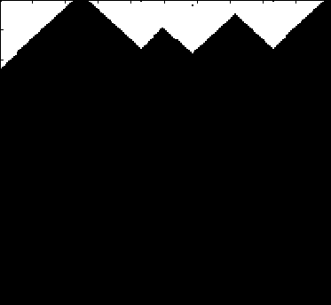
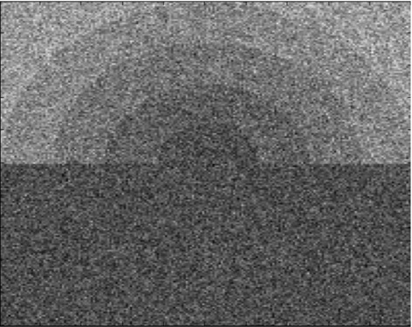
Asynchronous Belief Propagation
Challenge = Boundaries
Many
Updates
Synthetic Noisy Image
Few
Updates
Cumulative Vertex Updates
Algorithm identifies and focuses
on hidden sequential structure
Graphical Model
Notes:
Cummulative vertex update movie

Slide 29
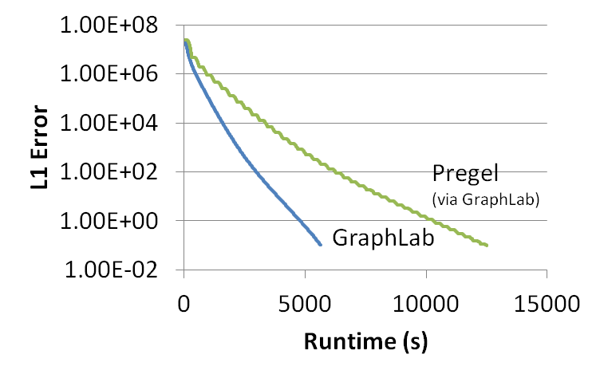
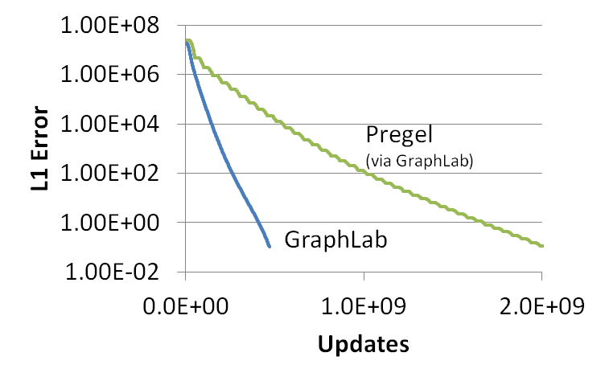
GraphLab vs. Pregel (BSP)
51% updated only once
Multicore PageRank (25M Vertices, 355M Edges)

Slide 30
Graph-parallel Abstractions
Better for ML
Pregel
Messaging
Shared State
i
i
Synchronous
Asynchronous

Slide 31

Challenges of High-Degree Vertices
Sequentially process edges
Sends many
messages
(Pregel)
Touches a large
fraction of graph
(GraphLab)
Edge meta-data too large for single machine
Asynchronous Execution requires heavy locking (GraphLab)
Synchronous Execution prone to stragglers (Pregel)

Slide 32
Communication Overhead for High-Degree Vertices
Fan-In vs. Fan-Out

Slide 33
Pregel Message Combiners on Fan-In
Machine 1
Machine 2
A
Sum
B
+
D
C
User defined commutative associative (+) message operation:

Slide 34
Pregel Struggles with Fan-Out
Machine 1
Machine 2
A
B
D
C
Broadcast sends many copies of the same message to the same machine!

Slide 35
Fan-In and Fan-Out Performance
PageRank on synthetic Power-Law Graphs
Piccolo was used to simulate Pregel with combiners
High Fan-Out Graphs
High Fan-In Graphs
More high-degree vertices

Slide 36
GraphLab Ghosting
Machine 1
Machine 2
A
A
B
D
B
D
C
Ghost
C
Changes to master are synced to ghosts

Slide 37
GraphLab Ghosting
Machine 1
Machine 2
A
A
B
D
B
D
C
C
Ghost
Changes to neighbors of high degree vertices creates substantial network traffic

Slide 38
Fan-In and Fan-Out Performance
PageRank on synthetic Power-Law Graphs
GraphLab is undirected
Pregel Fan-Out
GraphLab Fan-In/Out
Pregel Fan-In
More high-degree vertices

Slide 39
Graph Partitioning
Graph parallel abstractions rely on partitioning:
Minimize communication
Balance computation and storage
Y
Data transmitted
across network
O(# cut edges)
Machine 1
Machine 2

Slide 40
Random Partitioning
Both GraphLab and Pregel resort to random (hashed) partitioning on natural graphs
Machine 1
Machine 2
10 Machines → 90% of edges cut
100 Machines → 99% of edges cut!

Slide 41
In Summary
GraphLab and Pregel are not well suited for natural graphs
Challenges of high-degree vertices
Low quality partitioning

Slide 42
PowerGraph
GAS Decomposition: distribute vertex-programs
Move computation to data
Parallelize high-degree vertices
Vertex Partitioning:
Effectively distribute large power-law graphs

Slide 43
A Common Pattern for Vertex-Programs
GraphLab_PageRank(i)
// Compute sum over neighbors
total = 0
foreach( j in in_neighbors(i)):
total = total + R[j] * w_{ji}
// Update the PageRank
R[i] = 0.1 + total
// Trigger neighbors to run again
if R[i] not converged then
foreach( j in out_neighbors(i))
signal vertex-program on j
Gather Information About Neighborhood
Update Vertex
Signal Neighbors &
Modify Edge Data

Slide 44
GAS Decomposition
Gather (Reduce)
Apply
Scatter
Accumulate information about neighborhood
Apply the accumulated value to center vertex
Update adjacent edges and vertices.
User Defined:
User Defined:
User Defined:
Gather( ) → Σ
Apply( , Σ) →
Scatter( ) →
Y
Y
Y’
Y’
Σ₁ + Σ₂ → Σ₃
Σ
Y’
Y
Y’
Y
Update Edge Data &
Activate Neighbors
Parallel Sum
+
+ … + →
Y
Y
Y

Slide 45
PageRank in PowerGraph
PowerGraph_PageRank(i)
Gather( j → i ) : return w_{ji} * R[j]
sum(a, b) : return a + b;
Apply(i, Σ) : R[i] = 0.15 + Σ
Scatter( i → j ) : if R[i] changed then trigger j to be recomputed

Slide 46
Distributed Execution of a PowerGraph Vertex-Program
Machine 1
Machine 2
Master
Gather
Y’
Y’
Y’
Y’
Σ₁
Σ
Σ₂
+ + +
Mirror
Apply
Y
Y
Y
Y
Machine 3
Machine 4
Scatter
Σ₃
Σ₄
Mirror
Mirror

Slide 47
Dynamically Maintain Cache
Repeated calls to gather wastes computation:
Solution: Cache previous gather and update incrementally
Wasted computation
Y
+ + … + + → Σ’
Y
Y
Y
Y
Δ
Cached Gather (Σ)
Old Value
New Value
+ +…+ + Δ → Σ’
Y
Y
Y
Y
Y

Slide 48
PageRank in PowerGraph
PowerGraph_PageRank(i)
Gather( j → i ) : return w_{ji} * R[j]
sum(a, b) : return a + b;
Apply(i, Σ) : R[i] = 0.15 + Σ
Scatter( i → j ) : if R[i] changed then trigger j to be recomputed
Post Δ_{j} = w_{ij} * (R[i]^{new} - R[i]^{old})
Reduces Runtime of PageRank by 50%!

Slide 49
Caching to Accelerate Gather
Machine 1
Machine 2
Machine 2
Skipped Gather Invocation
Master
Gather
Y
Y
Σ₁
Σ
Σ₂
+ + +
Mirror
Machine 3
Machine 4
Σ₃
Σ₄
Y
Y
Mirror
Mirror

Slide 50
Minimizing Communication in PowerGraph
Communication is linear in the number of machines each vertex spans
Y
Y
Y
A vertex-cut minimizes machines each vertex spans
Percolation theory suggests that power law graphs have good vertex cuts. [Albert et al. 2000]

Slide 51
New Approach to Partitioning
Rather than cut edges:
we cut vertices:
CPU 1
CPU 2
Must synchronize
many edges
New Theorem: For any edge-cut we can directly construct a vertex-cut which requires strictly less communication and storage.
Y
Y
CPU 1
CPU 2
Y
Must synchronize a single vertex
Y

Slide 52
Constructing Vertex-Cuts
Evenly assign edges to machines
Minimize machines spanned by each vertex
Assign each edge as it is loaded
Touch each edge only once
Propose three distributed approaches:
Random Edge Placement
Coordinated Greedy Edge Placement
Oblivious Greedy Edge Placement

Slide 53
Random Edge-Placement
Randomly assign edges to machines
Machine 1
Machine 2
Machine 3
Balanced Vertex-Cut
Y
Spans 3 Machines
Y
Y
Y
Y
Y
Z
Y
Z
Y
Y
Y
Z
Z
Spans 2 Machines
Not cut!

Slide 54
Analysis Random Edge-Placement
Expected number of machines spanned by a vertex:
Twitter Follower Graph
41 Million Vertices
1.4 Billion Edges
Accurately Estimate Memory and Comm. Overhead

Slide 55
Random Vertex-Cuts vs. Edge-Cuts
Expected improvement from vertex-cuts:
Order of Magnitude
Improvement

Slide 56
Greedy Vertex-Cuts
Place edges on machines which already have the vertices in that edge.
Machine1
Machine 2
A
B
B
C
A
B
D
E

Slide 57
Greedy Vertex-Cuts
De-randomization → greedily minimizes the expected number of machines spanned
Coordinated Edge Placement
Machines coordinate to place next set of edges
Slower → higher quality cuts
Oblivious Edge Placement
Approx. greedy objective without coordination
Faster → lower quality cuts

Slide 58
Partitioning Performance
Twitter Graph: 41M vertices, 1.4B edges
Cost
Construction Time
Random
Oblivious
Better
Oblivious
Coordinated
Coordinated
Random
Oblivious balances cost and partitioning time.

Slide 59
Greedy Vertex-Cuts Improve Performance
Greedy partitioning improves computation performance.

Slide 60
System Design

Slide 61
System Design
PowerGraph (GraphLab2) System
MPI/TCP-IP
PThreads
HDFS
EC2 HPC Nodes
Implemented as C++ API
Uses HDFS for Graph Input and Output
Fault-tolerance is achieved by check-pointing
Snapshot time < 5 seconds for twitter network

Slide 62
PowerGraph Execution Models
Synchronous and Asynchronous
(Pregel) (GraphLab)

Slide 63
Synchronous Execution
Similar to Pregel
For all active vertices
Gather
Apply
Scatter
Activated vertices are run on the next iteration
Fully deterministic
Slower convergence for some machine learning algorithms

Slide 64
Asynchronous Execution
Similar to GraphLab
Active vertices are processed asynchronously as resources become available.
Non-deterministic
Faster for some machine learning algorithms
Optionally enforce serializable execution

Slide 65
Implemented Many Algorithms
Collaborative Filtering
Alternating Least Squares
Stochastic Gradient Descent
SVD
Non-negative MF
Statistical Inference
Loopy Belief Propagation
Max-Product Linear Programs
Gibbs Sampling
Graph Analytics
PageRank
Triangle Counting
Shortest Path
Graph Coloring
K-core Decomposition
Computer Vision
Image stitching
Noise elimination
Language Modeling
LDA

Slide 66
Multicore Performance
Pregel
GraphLab
GraphLab2
Caching
GraphLab2

Slide 67
Comparison with GraphLab & Pregel
PageRank on Synthetic Power-Law Graphs:
Communication
Runtime
Pregel (Piccolo)
Pregel (Piccolo)
GraphLab
GraphLab
PowerGraph
PowerGraph
High-degree vertices
High-degree vertices
PowerGraph is robust to high-degree vertices.
Notes:
All use random cuts

Slide 68
PageRank on the Twitter Follower Graph
Natural Graph with 40M Users, 1.4 Billion Links
Communication
Runtime
Total Network (GB)
Seconds
Reduces Communication
Runs Faster
32 Nodes x 8 Cores (EC2 HPC cc1.4x)

Slide 69


PowerGraph is Scalable
Yahoo Altavista Web Graph (2002):
One of the largest publicly available web graphs
1.4 Billion Webpages, 6.6 Billion Links
7 Seconds per Iter.
1B links processed per second
30 lines of user code
64 HPC Nodes
1024 Cores (2048 HT)

Slide 70





Collaborative Filtering
Factorize Matrix (11M vertices, 315M edges)
Asynchronous
Users
Ratings
Movies
Serializable
Consistency = Lower Throughput

Slide 71
Collaborative Filtering
Consistency → Faster Convergence
Asynchronous
Serializable
Notes:
But on the most important metric of all. Faster convergence

Slide 72
Topic Modeling
English language Wikipedia
2.6M Documents, 8.3M Words, 500M Tokens
Computationally intensive algorithm
100 Yahoo! Machines
Specifically engineered for this task
64 cc2.8xlarge EC2 Nodes
200 lines of code & 4 human hours

Slide 73
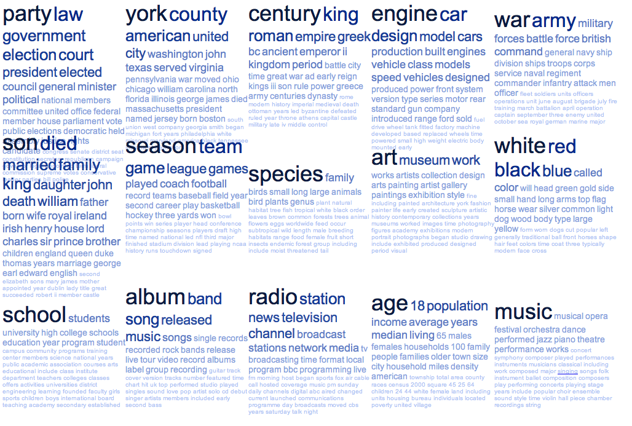
Example Topics Discovered from Wikipedia

Slide 74
Triangle Counting on The Twitter Graph
Identify individuals with strong communities.
Counted: 34.8 Billion Triangles
Hadoop [WWW’11]
1536 Machines
423 Minutes
64 Machines
1.5 Minutes
282 x Faster
PowerGraph
Why? Wrong Abstraction → Broadcast O(degree²) messages per Vertex
S. Suri and S. Vassilvitskii, “Counting triangles and the curse of the last reducer,” WWW’11
Notes:
S. Suri and S. Vassilvitskii, “Counting triangles and the curse of the last reducer,” presented at the WWW '11: Proceedings of the 20th international conference on World wide web, 2011.

Slide 75
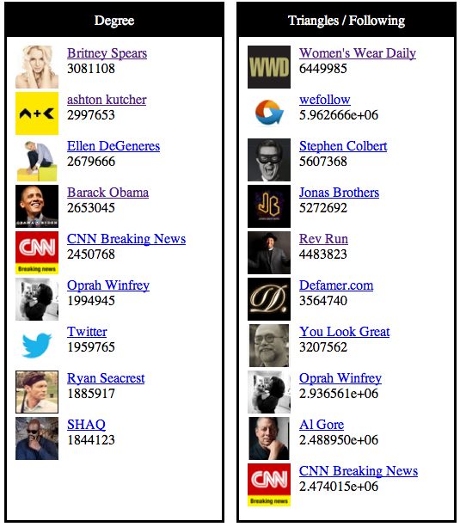
Results of Triangle Counting on Twitter
Popular People
With
Strong Communities
Popular People

Slide 76
Summary
Problem: Computation on Natural Graphs is challenging
High-degree vertices
Low-quality edge-cuts
Solution: PowerGraph System
GAS Decomposition: split vertex programs
Vertex-partitioning: distribute natural graphs
PowerGraph theoretically and experimentally outperforms existing graph-parallel systems.

Slide 77
Machine Learning and Data-Mining Toolkits
Graph Analytics
Graphical Models
Computer Vision
Clustering
Topic Modeling
Collaborative Filtering
PowerGraph (GraphLab2) System

Slide 78

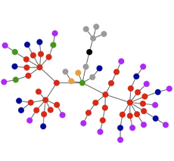

GraphChi: Going small with GraphLab
Solve huge problems on small or embedded devices?
Key: Exploit non-volatile memory (starting with SSDs and HDs)

Slide 79
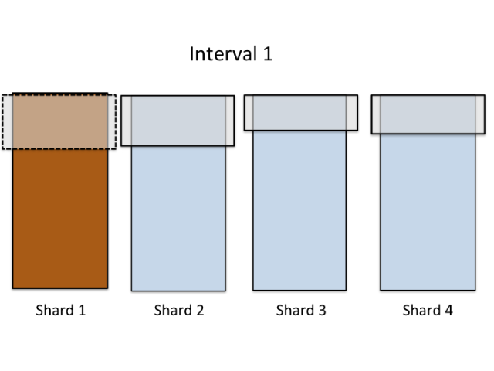
GraphChi – disk-based GraphLab
Fast!
Solves tasks as large as current distributed systems
Minimizes non-sequential disk accesses
Efficient on both SSD and hard-drive
Parallel, asynchronous execution
Novel Parallel Sliding
Windows algorithm

Slide 80
Triangle Counting in Twitter Graph
40M Users 1.2B Edges
Total: 34.8 Billion Triangles
1536 Machines
423 Minutes
59 Minutes, 1 Mac Mini!
64 Machines, 1024 Cores
1.5 Minutes
Hadoop results from [Suri & Vassilvitskii '11]
Notes:
Hadoop [1] S. Suri and S. Vassilvitskii, “Counting triangles and the curse of the last reducer,” presented at the WWW '11: Proceedings of the 20th international conference on World wide web, 2011.

Slide 81
is GraphLab Version 2.1 Apache 2 License
PowerGraph
http://graphlab.org
Documentation… Code… Tutorials… (more on the way)

